Slide 1


William Hunter Weekly Update: Week of 7/1
Oppoturtinity Hunter
July 1st, 2019

Slide 2

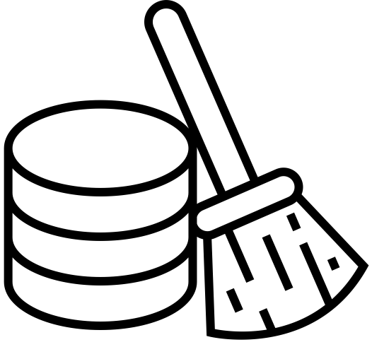

Weekly Objectives
What did I hope to achieve?
Create a master table
Pave the way for full automation
Scrape multiple sites at once
July 1, 2019

Slide 3

Creation of Master Table
Weekly Progress
Clean Pivot Tables
Have to clean the data to be a fixed format in the pivot tables first.
Merge Into Master
Move all the data to the master table in a fixed format, with many columns.
Delete Duplicates
Have the master table recognize when there are duplicate jobs and outdated jobs.
Move to Current
Move all current jobs to a new table, tracks new insertions as well.
July 1, 2019

Slide 4

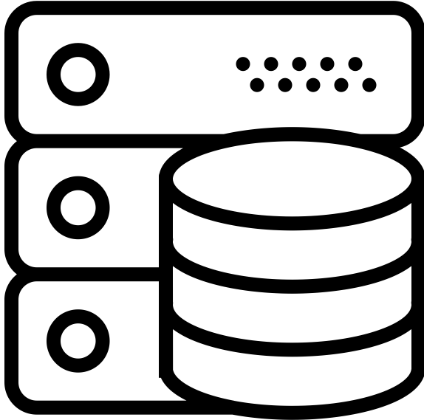

Moving Towards Full Automation
Weekly Progress
Migrated all sites to a single python script
Combined all SQL queries into master function
Next step is running these automatically
July 1, 2019

Slide 5
Scraping Multiple Sites
Weekly Progress
Able to scrape and store multiple sites
Current Sites:
NYSCR
DASNY
GOV.UK
RFPDB
Each site has its own Pivot and Raw Table
Process takes around 200 seconds
Code is growing very large
Each site requires a large amount of individual attention
Numerous bugs for each site, and new approach needed based on HTML
July 1, 2019

Slide 6



Challenges Encountered
Preliminary Difficulties with Opportunity Hunter
Scaling
I have come to the conclusion that automatically adding sites is borderline impossible. From finding the correct HTML elements, to have each element is parented,
to SQL cleaning, it
has to be done by hand.
Next Sites
I have looked through all sites that Peter sent me, and either they are unusable because of PDFs, or I have scrapped them, so I need more sights to look at, or can expand to networking events.
Dates
The thing that causes the tables the most trouble is the dates. I want to put them in as a datetime object so we can get rid of the outdated jobs, so a lot of cleaning is
needed.
July 1, 2019

Slide 7




Expected Next Steps
Progressing Opportunity Hunter
Email Results
Figure out a way to automatically email the results to the team in a way that the get the most relevant content.
Implement ML
More of a long term goal, but lay groundwork for a ML system that recognizes which jobs the team will like to see.
Add More Sites
Currently around 101 jobs are being added daily. The short term goal is to have 10 sites, and to look for more applicable jobs.
Clean Python
The Python Code is growing quite large with all the different clauses for the sites, and needs to be more straight forward.
July 1, 2019

